Slide 1
Attrition in Ibm
Senhao Li

Slide 2
Data
A fictional data created by IBM scientists;
To explore the factors that cause employees’ attrition;
To provide employers strategies in human resource.
Age
Attrition
Department
Distance From Home
Education
Gender
Job Level
Marital Status
Over Time
Performance
Total Working Years
Years At Company
Years In Current Role

Slide 3
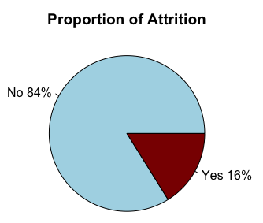
descriptive analysis
Among 1,470 employees, 237 of them leave the company, accounting for 16% of the total.

Slide 4
descriptive analysis
There is a slightly higher proportion of attrition in male employees;
And an obviously higher proportion of attrition within the group who work over time.

Slide 5
descriptive analysis
There is an obviously higher proportion of attrition within the single group;
And the sales department has the highest proportion of attrition, followed by HR department.

Slide 6
numerical analysis
Age:
Except two outliers within the Attrition group, those who leave the company are generally younger than those who stay.

Slide 7
numerical analysis
Income :
Generally, the employees within attrition group gain less salaries except some outliers;
The income of the attrition group are more concentrated than non-attrition group, which means that the income of these employees is similarly low;
Within the attrition group, the median is closer to the bottom line, showing that around 50% of these employees‘ monthly income is $2,500 or below.

Slide 8
numerical analysis
Distance from Home:
Generally, Employees who leave the company live farther than those who stay.

Slide 9
numerical analysis
Years in Current Role:
Except some outliers, those who leave the company generally have working for less time in their current roles.

Slide 10
Distribution analysis
Age:
The Attrition group’s age distribution is more right-skewed.

Slide 11
Distribution analysis
Monthly Income:
The Attrition group’s monthly income distribution is more right-skewed, and more concentrated around $2,500.

Slide 12
Distribution analysis
Years at Company:
The distribution of years that Attrition group have worked at the company is more right-skewed, and more concentrated around 2-3 years.

Slide 13
Central Limit Theorem
Monthly Income:
1,000 random samples
Random sampling without replacement
The distributions of these samples’ means are close to normal distribution;
as sample size getting larger, the SDs of these distributions decrease, while their means are the same:
Sample Size = 10 Mean = 6528 SD = 1537
Sample Size = 20 Mean = 6516 SD = 1071
Sample Size = 30 Mean = 6519 SD = 841
Sample Size = 40 Mean = 6498 SD = 736.2

Slide 14
Confidence intervals
Confidence level = 80%:
Sample size=20
The population mean is 6,503;
4 samples’ confidence intervals fail to lie on the population mean.

Slide 15
Confidence intervals
Confidence level = 90%:
Sample size=20
The population mean is 6,503;
Only 1 sample’s confidence intervals fail to lie on the population mean.

Slide 16
Thank you

